Slide 1
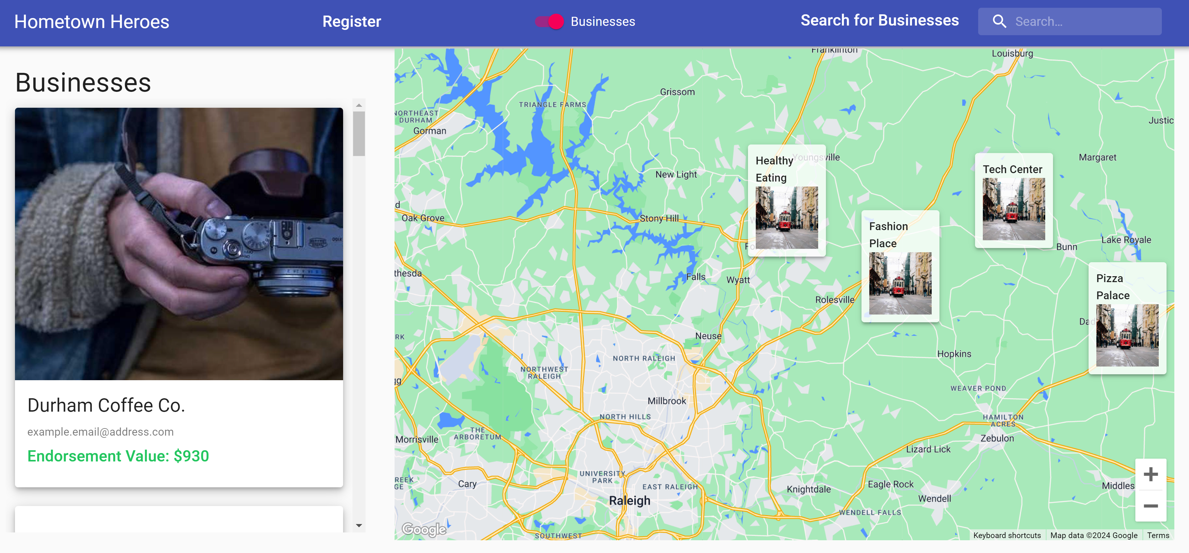
Hometown Heroes
Bridging the Gap Between Local Businesses and Student Athletes

Slide 2
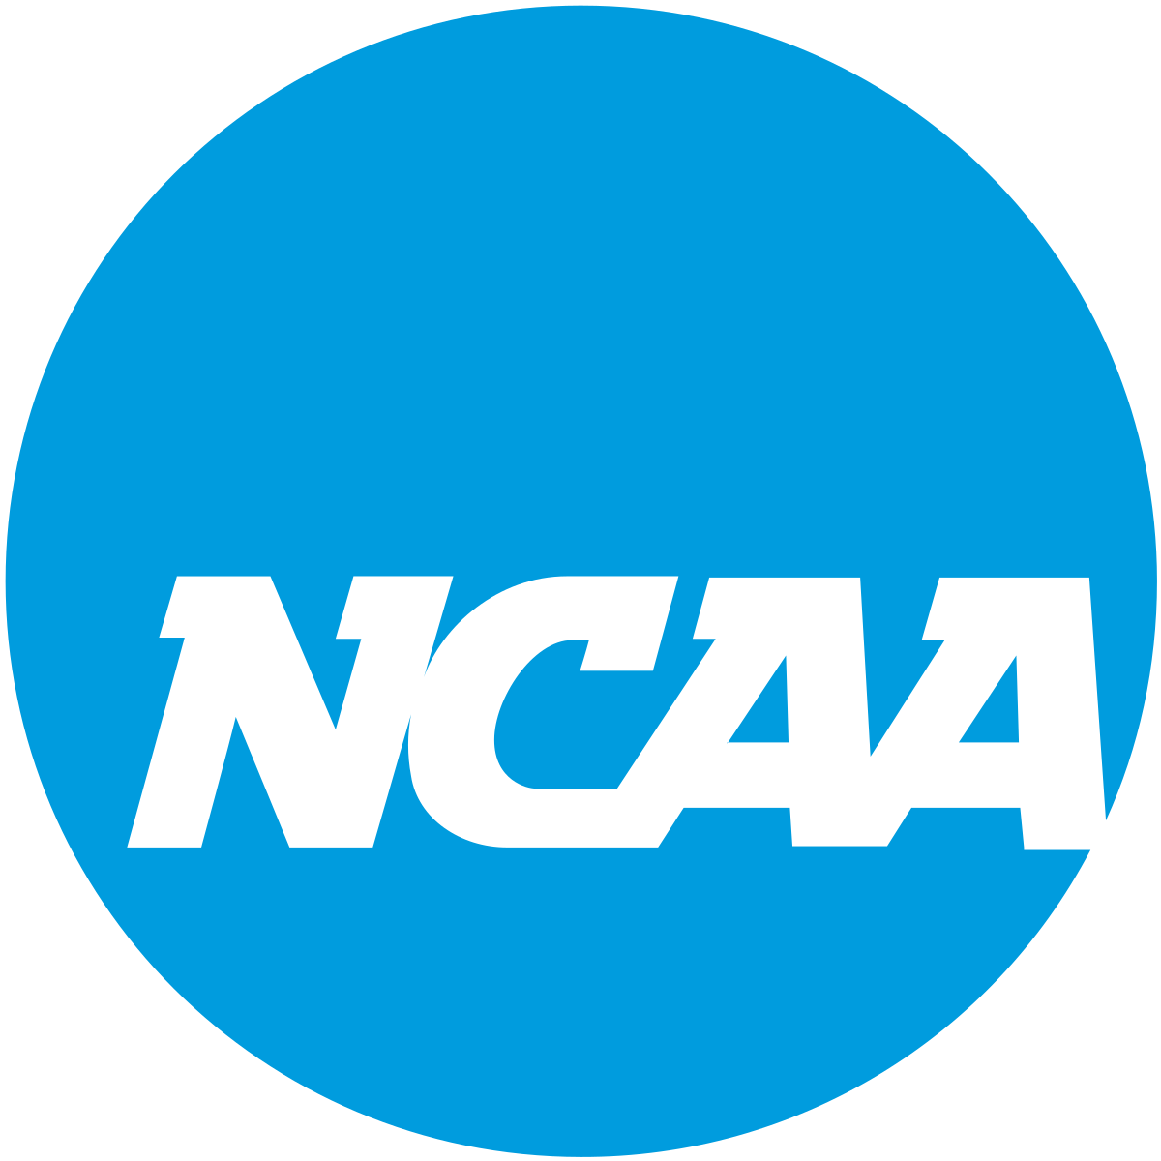
NIL (Name Image Likeness)
Recent update to NCAA regulations has allowed athletes to monetize their NIL rights.
Over $1 Billion Market
NIL deals may range from large sponsorships via collectives to individual endorsements.

Slide 3
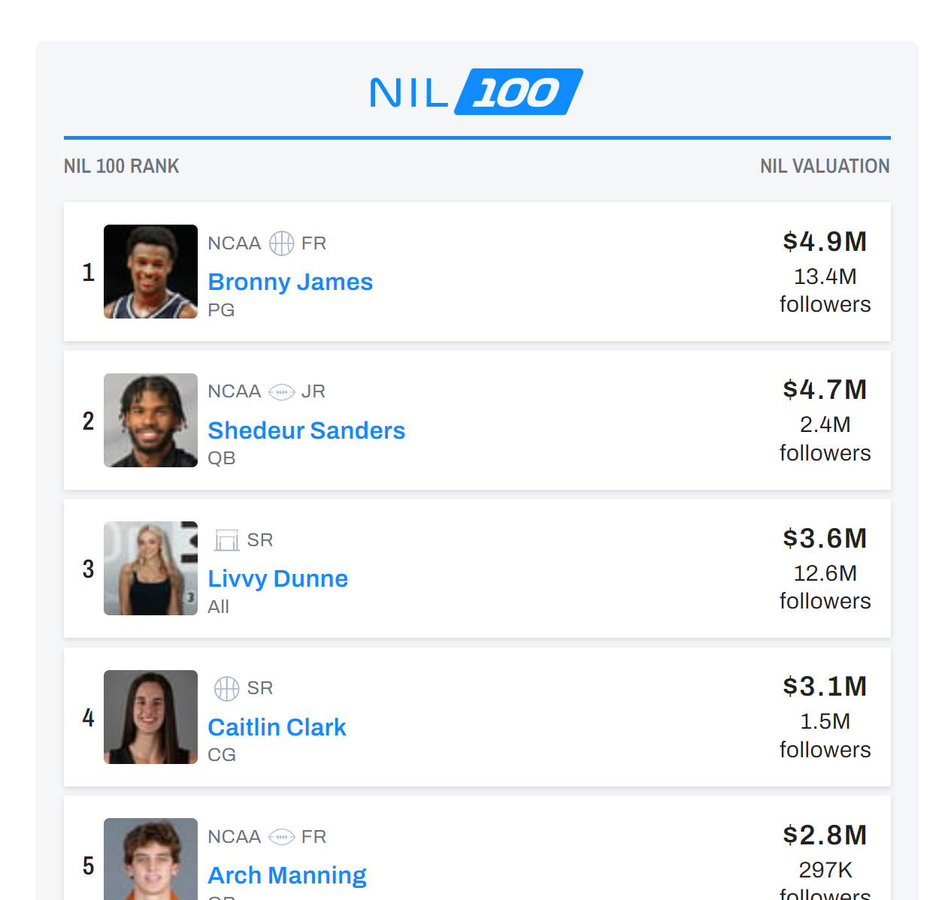
NIL Evaluations
A select few NCAA athletes have outsized NIL valuations.
Valuations reaching millions of dollars, largely due to social media following, school visibility, or public profile.
Most NCAA athletes do not command such high value.
Average around $1000-$10000
https://athleticdirectoru.com/articles/how-much-is-nil-really-worth-to-student-athletes/

Slide 4
Connecting Small Time Players
Hoped to design a platform that connects smaller businesses with local athletes.
Adding transparency to a growing, yet potentially largely untapped market.

Slide 5





Perspective: Athletes
See local businesses hoping to make endorsement deals
Reach out to businesses looking for athletes matching their profile.
Sport
School
Hometown
Receive messages from potential endorsement providers.

Slide 6



Perspective: Businesses
See NCAA athletes willing to accept endorsement deals.
View the profiles of potential athletes to determine good market fit.
Reach out to athletes with potential endorsement deals.

